Slide 1
Spear Phishing

Slide 2
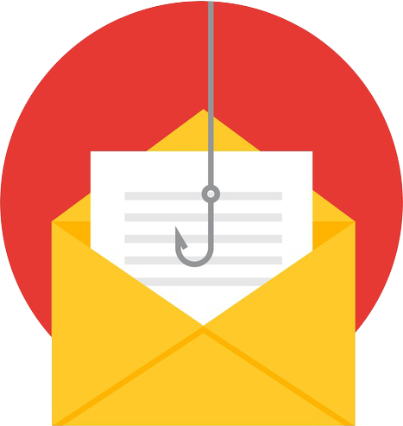
Spear Phishing
Common cause of data breaches
Targeted emails
Sent to small groups or individuals
Uses social engineering tactics
Notes:
Common cause of data breaches
Targeted emails
Spear phishing messages are targeted at small groups or individuals. Attackers personalize these messages to bypass technical controls like spam filters.
Sent to small groups or individuals
Use social engineering tactics
Examples of social engineering tactics:
Pretexting: Exploiting the authority of another person or organization (e.g. pretending to be the IT department to solicit a password)
Baiting: dangling an item (or file) of value
Appealing to emotions or sense of urgency

Slide 3
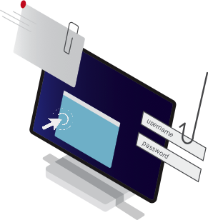
Spear Phishing Emails
Deliver file attachments
Entice you to click on links
Trick you into handing over your login credentials
Notes:
Spear phishing emails:
Deliver file attachments that can infect your computer with malware
Entice you to click on links that take you to websites that will infect your computer
Trick you into handing over your login credentials, which phishers can later use to gain access to your network, sites, and data

Slide 4
Type #1: Highly Personalized
Spear phishers personalize emails to try to gain your trust
  Full name
  Mailing address
  Bank account number
  Name of your employer
Even if the email or text message appears to be from someone you know, use caution.
Notes:
Examples of advanced spear phishing attacks include Highly Personalized, Double Barrel, and Business Email Compromise.
Highly Personalized phishing emails include personal information to gain the target’s trust.
Spear phishers often use information like your full name, mailing address, tax ID number, phone number, bank account number, and the name of your employer to try to gain your trust.
Spear phishers scavenge social media profiles to craft highly personalized messages. They could also use information like the names of your family, friends, and colleagues to trick you into clicking a link or downloading an attachment. Every bit of information you post on a social network makes you vulnerable to spear phishing.
Even if the email or text message appears to be from someone you know, use caution. Phishers can also impersonate email addresses and phone numbers.

Slide 5
Type #1: Highly Personalized
Notes:
This example of a real phishing email includes the target’s email address (redacted) to establish a sense of trust.

Slide 6
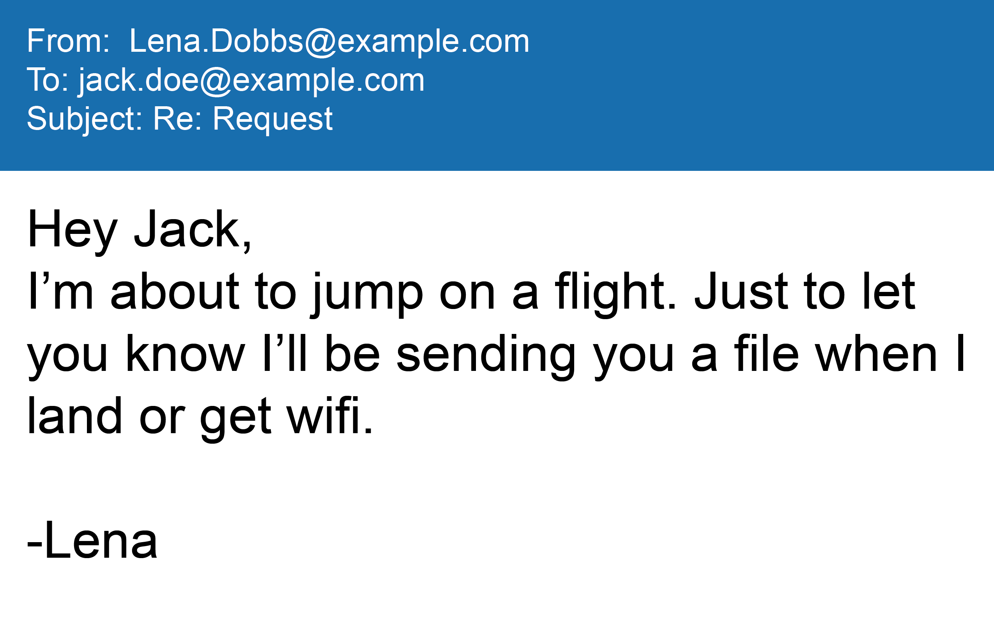
Type #2: Double Barrel
The Double Barrel uses multiple emails to create a believable narrative.
The Lure:
The first email is designed to build trust
Notes:
The Double Barrel uses multiple emails to create a believable narrative.
First, phishers send a Lure email designed to build trust. In this example, Jack receives an email from his boss Lena, letting him know that she is about to get on a flight and to expect a file soon.
In this email, the phisher tells the target to expect another email with an attachment or link.

Slide 7
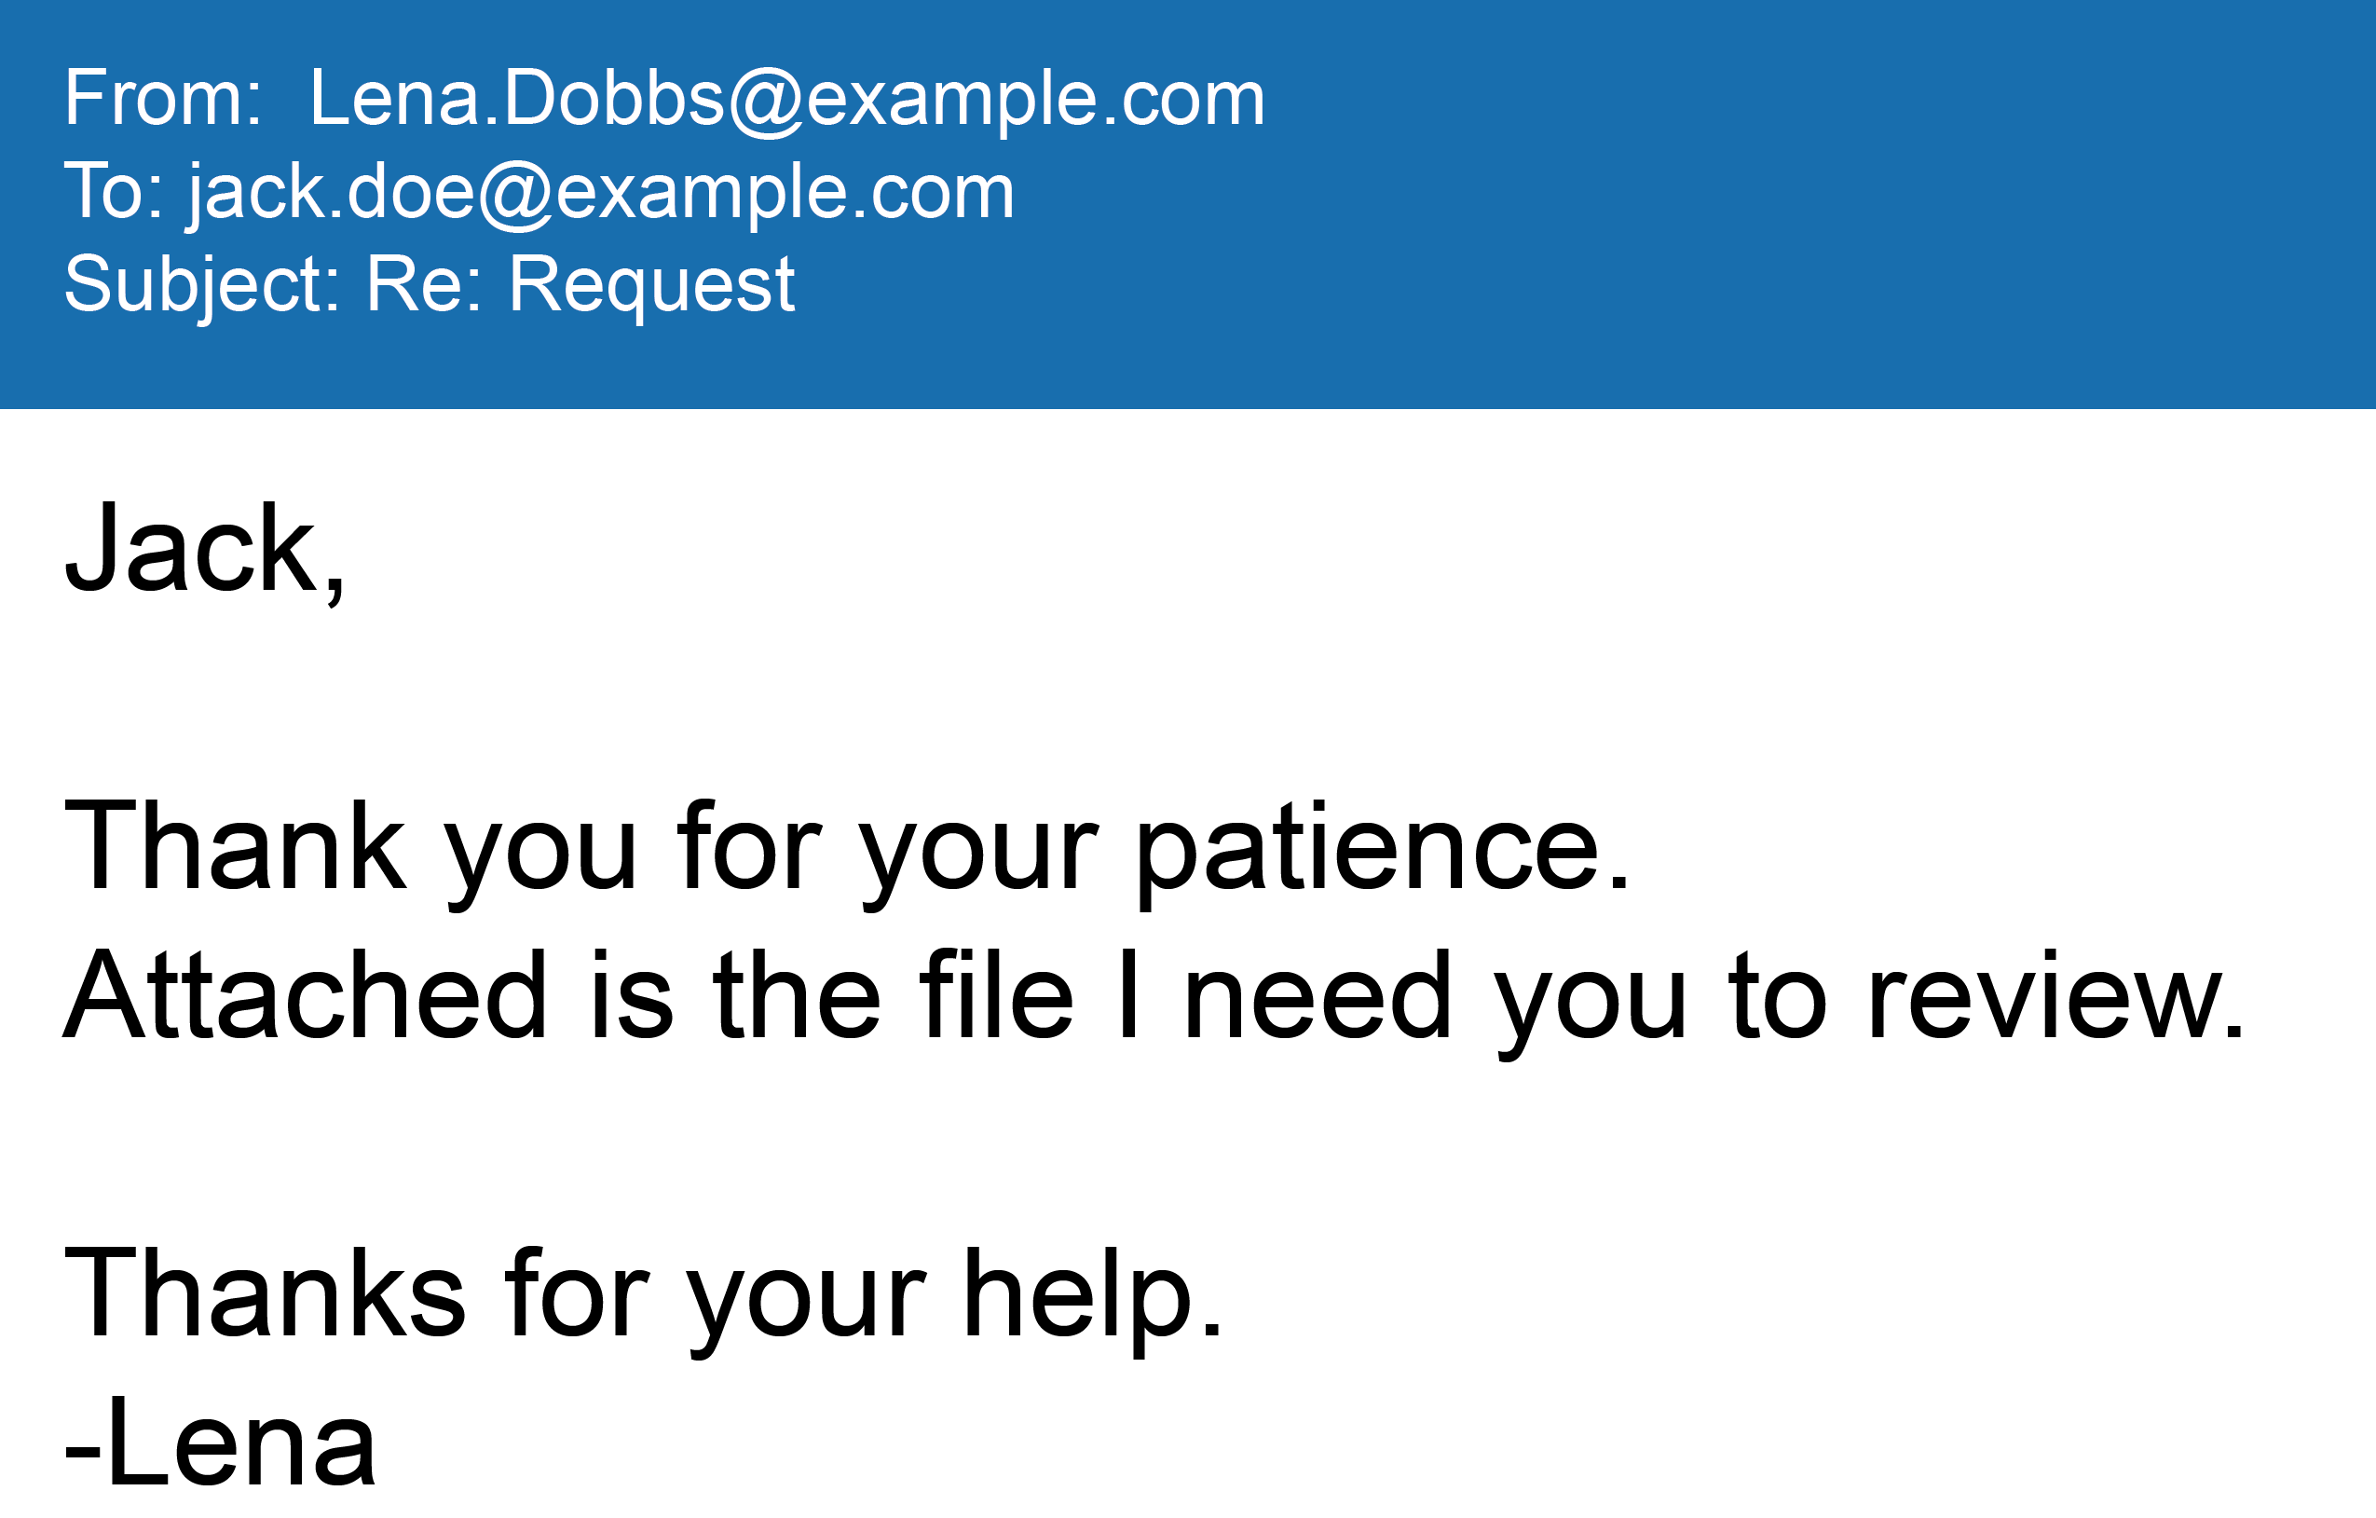
Type #2: Double Barrel
The Phish:
The second email contains malicious attachments or links

Slide 8
Type #3: Business Email Compromise
Use email to solicit wire transfers
Impersonate executives or vendors/suppliers
Resemble spear phishing
Targets financial officers
Phishers have stolen billions of dollars in these scams.
Notes:
A Business Email Compromise scam uses emails to trick recipients into initiating a fraudulent wire transfer, often by impersonating a high-ranking executive or a vendor/supplier.
A BEC scam may resemble a spear phishing attack.
However, it does not always contain a malicious hyperlink or attachment.
Most often, BEC scams target financial officers and other employees who are authorized to initiate a wire transfer, like financial directors and accountants.
According to the United States FBI, phishers have stolen over 5.3 billion dollars in these scams as of 2017.

Slide 9
Type #3: Business Email Compromise
Notes:
Here is an example of an attempt against PhishMe. Our VP of Finance was able to identify the BEC scam because the email says “Sent from my iPhone,” but he knew Rohyt uses Android.
There are a few formatting mistakes (an extra space before “?”) and punctuation errors (“i”). That’s no surprise since errors in punctuation, spelling, grammar and formatting are common in phishing emails.

Slide 10
Why You Should Be Concerned
The global cost of cyber crime may be as much as $600 billion[1]
$12.5 Billion worldwide losses due to BEC and EAC [2]
150 Countries have recently been impacted by BEC scams [2]
References:
[1] – McAfee. “Economic Impact of Cybercrime- No Slowing Down” https://www.mcafee.com/enterprise/en-us/assets/reports/restricted/economic-impact-cybercrime.pdf
[2] – Federal Bureau of Investigation. “Business E-Mail Compromise the 12 Billion Dollar Scam” https://www.ic3.gov/media/2018/180712.aspx

Slide 11
How to Spot a Phish
Look closely for errors
  Grammar
  Spelling
  Punctuation
  Syntax
Look for Contextual Clues
  Device
  Tone
  Signature

Slide 12
Prevent Spear Phishing Attacks
Never download strange/unsolicited attachments
Update software frequently
Back up your files regularly
Use caution while surfing the web and checking your inbox
Keep your emotions in check
Always verify

Slide 13
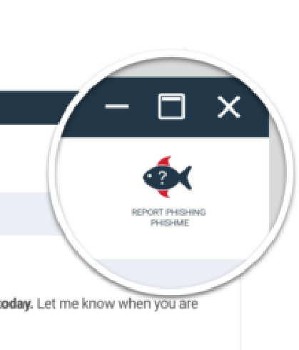
Report Spear Phishing
Report any suspected threats
Help stop attacks
Protect your co-workers
Protect customer data

Slide 14
Related Resources
Whitepapers
  Business Email Fraud Scams: What They Are and How to Shut Them Down
  https://cofense.com/whitepaper/learn-best-practices-to-fight-evolving-email-related-threats/
Blog posts
  Threat Actors Continue Abusing Google Docs and Other Cloud Services to Deliver Malware
  FBI Announces That BEC Scam Losses Continue to Skyrocket, as Losses Exceed $3.1B
  BEC Scams Hits Technology Giants for over $100 Million Dollars
CBT
  Advanced Spear Phishing
  BEC Scams
Infographics
  How to Spot a Phish
  Phishing and Social Media
  How to Shield Your Company from BEC Attacks

Slide 15
QUESTIONS?

